Slide 2
A few logistics
Everyone is muted so we can all hear well
We are recording this call. The recording, chat, this Power Point and any meeting materials will be posted at earlylearningnh.org/meetings by the end of the day today.
Please use the Chat or Email info@earlylearningnh.org for technical issues or to share your experiences, questions, ideas, tips and solutions throughout the call
If you would like to receive a certificate please type “certificate” along with your name, your email, and the name of your child care program
Notes:
Jackie

Slide 3
Today’s Agenda 6/13/2024
NHCCAC Meeting
Welcome, Introductions, and Logistics
Legislative Updates
Bureau of Child Development and Head Start Collaboration Updates
Bureau of Child Care Licensing Updates
Watch Me Grow Information
Get the Lead Out program information
Public Announcements
Q & A / Wrap Up

Slide 4
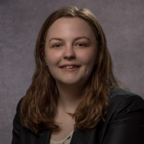
Legislative Updates
Lauren Martin
Community Engagement Coordinator
Contact Info
Email: lmartin@new-futures.org
Phone Number: (603) 225-9540 x100

Slide 6
Bureau of Child Development and Head Start Collaboration
Jessie Davis, Bureau Chief

Slide 7
Bureau of Child Care Licensing
Melissa Clement, Bureau Chief

Slide 9
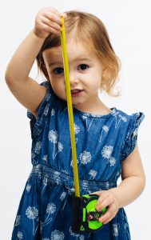
Audrey Gerkin, M.Ed
Systems of Care Specialist
NH DHHS | Division of LTSS
Bureau for Family Centered Services
Office: 603-271-7267
Fax: 603-271-4902
Audrey.F.Gerkin@dhhs.nh.gov

Slide 10
NH Get the Lead Out of Drinking Water Program
New Hampshire Child Care Advisory Council
June 13, 2024
Laurie R. Rardin
Environmental Health Coordinator
Environmental Public Health Tracking
NH Division of Public Health Services
laurie.r.rardin@dhhs.nh.gov │ 603-271-0357

Slide 11
Public Announcements

Slide 12
Questions?

Slide 13
Child Care Advisory Council Contact Information
Chair- Marianne Barter mariannebarter@gmail.com
Vice Chair- Lynn Ouellette
louellette@nelliestreehouse.com
Secretary- Jackie Firmin
jackie@nhaeyc.info
Director- Shannon Tremblay shannontremblay98@gmail.com
stremblay@nhccac.org
Questions, Comments, Concerns ALWAYS welcome!

